Slide 1

Initiative 1: One Bridge
Bringing Business & Technology Together
Crowded House Innovators::
Awais Sultan, Stacie Kenney, Pawan Tipre
Notes:
Note: This is the Hoan bridge, in Milwaukee, with the US Bank tower in the background ;-)

Slide 2


HUNCH
There are a few existing systems that do part of the job
We believe by creating a cohesive and collaborative solution, where the business and technology can come together, we can drive greater problem solving and implementation of ideas.
Essentially...
Creating – One Bridge (from Business to Technology)
Changing tough office work
… to kids play!

Slide 3


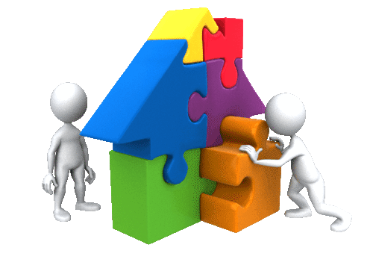




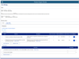
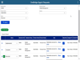
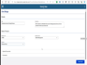
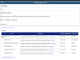
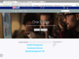
FUTURE
Journey
SCENARIO:
Ideas are collected to improve products.
GOALS & EXPECTATIONS:
Employees and product owners want to bring ideas to fruition.
One Dashboard shows status for ideas that also reports completed ideas that creates excitement for Natalie and Christina.
A dedicated team reviews all the One Bridge entries and determines the best home for resolution, all while keeping Natalie updated on progress.
Christiana review ideas submitted in her ideas intake tool and add them to OKRs.
Campaign is conducted to collect ideas from employees
Christiana contacts her TOS lead and also look at technology village to find additional resources
Natalie goes to one stop shop to submit her idea.
Idea / Problem Home
2
6
3
4
1
5
Value Proposition:
- The feeling of winning in the workplace can be very empowering.
Value Proposition:
- Ideas and problems occur throughout the day. This is natural.
Value Proposition:
- Marketing for One Bridge will be multi channel and recurring.
Value Proposition:
- Having a dedicated team with varied experiences working together is optimal.
Value Proposition:
- Improves product modeling, incorporating brilliant ideas
Value Proposition:
- Improves product modeling, incorporating brilliant ideas

Slide 4






MARKET
Everyone; the problem doesn’t discriminate and neither does our solution
Primary =
US Bank Business Lines – Integration with one stop shop to submit ideas like (Idea Verse, Idea Place) will help ideas flow into Product Modeling tools like DragonBoat
Product Modeling Teams/ Product Owners: Ideas are assigned to correct Products/ Product owners and flow into for example DragonBoat where OKRs can be defined for them. This way they can collect ideas to improve the product.
US Bank Innovation Group: Integration between different Innovation tools can build a complete Collaborative tool where Ideas can be realized by feeding them into how we do things (Product Modeling).
Secondary = US Bank Customers
If the employees are not operating at their best, then they cannot deliver their best to our customers.
One Bridge - from Business to Technology The only place you need to go for turning ideas or problems into future possibilities.
Idea / Problem Home

Slide 5
Initiative 2: OpenShift Product Owner
Container based platform for various technologies
Container based OpenShift Cluster in AWS where various technologies can be deployed and is similar to Kubernetes Cluster supported by Private Cloud team. Since we have setup OpenShift ourselves in AWS, we have an upper edge and can support this platform for US Bank.
Market
ODM team for Payment Services– They are looking into setting up environments all the way till Production in AWS. Sravan Nemuri is consulting us to install OpenShift clusters for them. However, we can own OpenShift platform ourselves instead and they can continue to own ODM installed in it.
Business Lines Interested in Process Mining- We are in conversation with business lines who are showing interest in Process Mining. We may need to setup PM environments till Production before BAW migrates to Azure. Thus, we can also install PM in OpenShift Clusters created in AWS
US Bank Innovation Group: They are using IBM Watson AI for their upcoming AI apps. IBM Watson AI is installed on Sandbox OpenShift environment in IBM cloud. But we can provide them more permanent solution and provide OpenShift Clusters in AWS where they can deploy their apps.

Slide 6
Initiative 3: DB Strategy – Move from Relational DB (SQL Server) to No SQL DB - Mongo
 | RDBMS (SQL Server) | Mongo | Atlas (Mongo IAS)
Infrastructure | Memory: 382.6 GB CPU: 48vCPU, 24 physical Storage: 3727.336 GB | Memory: 32 GB CPU: 8vCPU Storage: 2048 GB (With compression you get 65% data reduction) (50-75% reduced) | m50(32GB RAM, 8vCPU), 4096GB Disk (More disk, more IOPs in cloud) (50-75% reduced)
Licensing | For SVCKSA69901A0FK (Prod Server), 24 cores - 84K and then yearly maintenance. The other server, 8 cores - 28K with yearly maintenance. | Estimated licensing costs: [$99,500 - 1 RAM pool, up to 256 GB $64,490 – ½ RAM pool, up to 128 GB] $64,490 1/2 RAM pool (42.4% Cost Reduction) | Estimated licensing costs: $56,635 (M50 Tier) (49.4% Cost Reduction)
Development Cost Savings |  | 75% DB related development cost can be saved. Considering 25% of development work as DB work, we can achieve: 18.75% development cost savings | 75% DB related development cost can be saved. Considering 25% of development work as DB work, we can achieve: 18.75% development cost savings
Data Migration tool between RDBMS & Mongo | Relational Migrator: https://www.mongodb.com/products/tools/relational-migrator Mongo partner Capgemini is willing to help here, and they have a comprehensive tool for this.
Guide on AS-IS Conversion | https://gitlab.us.bank-dns.com/axsult1/db-techmod/-/blob/main/MongoBAW_Integarion.md
Guide on Optimized Conversion | https://gitlab.us.bank-dns.com/axsult1/db-techmod/-/blob/main/Implementation/Phase%202/Readme.md

Slide 7
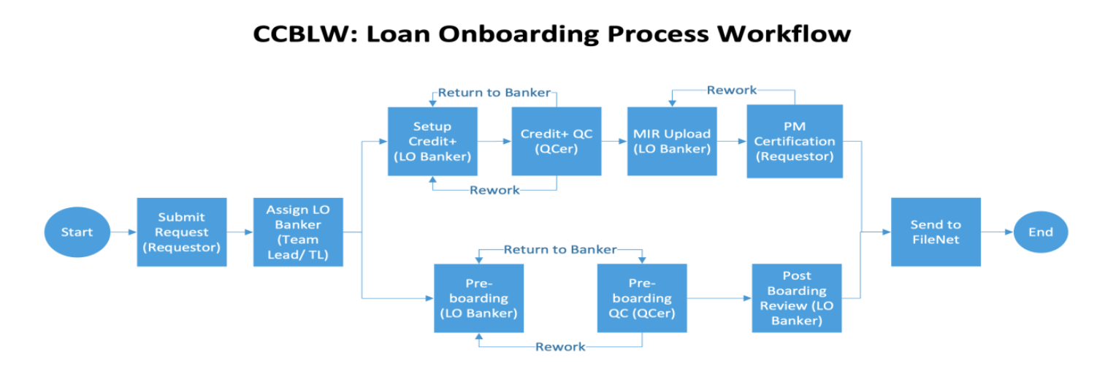
Business Case:
RDBMS is not great for the business case described here, but instead are good for SOR applications where data needs to be normalized into entities/tables and CRUD operations are performed on entities. Like If an organization has 70,000 employees, each employee has buildings’ access defined, this should be Saved in RDBS as Organization, Employee & Building tables. Otherwise. if building object is child of employee object & if there is change in building name then update will be required in thousands of places versus one place.
Object-oriented applications/workflows to handle Business Case entirely (Business Transaction Workflow), like Account or Loan Onboarding applications.
Some aspects of business Transactions are:
Data is captured from GUIs and is maintained in business objects within the scope of process instance.
Objects need to be saved As-Is or retrieved As-Is to prevent extra development effort for transformations for persistence.
Group of CRUD operations are performed as database transactions within the scope of Business Transaction.
There can be reports that can look outside Business Transactions, but CRUD operations for persistence specifically update, insert, delete are not performed by reports and it is just Reading data across Business transactions.
Any SOR data captured by Transactional application should be saved to appropriate SORs and it should not become SOR itself.
Data should be moved from Transaction application to Data Platform where data is transformed into a form to better suit Reports.
A Business transaction requires data consistency by nature.
Changes in handling of Business Transaction require changes in business Objects’ models so persistence layer should be flexible enough to accommodate their changes.

Slide 8
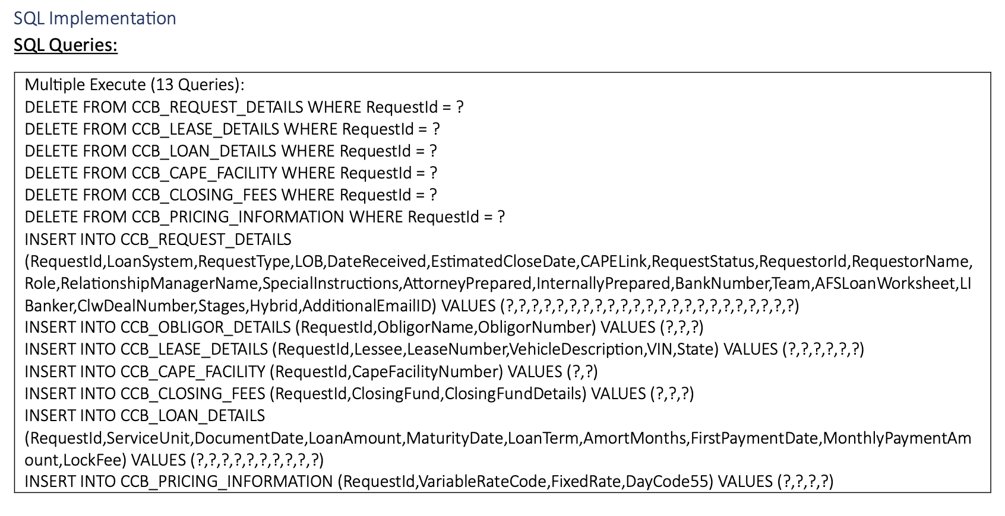
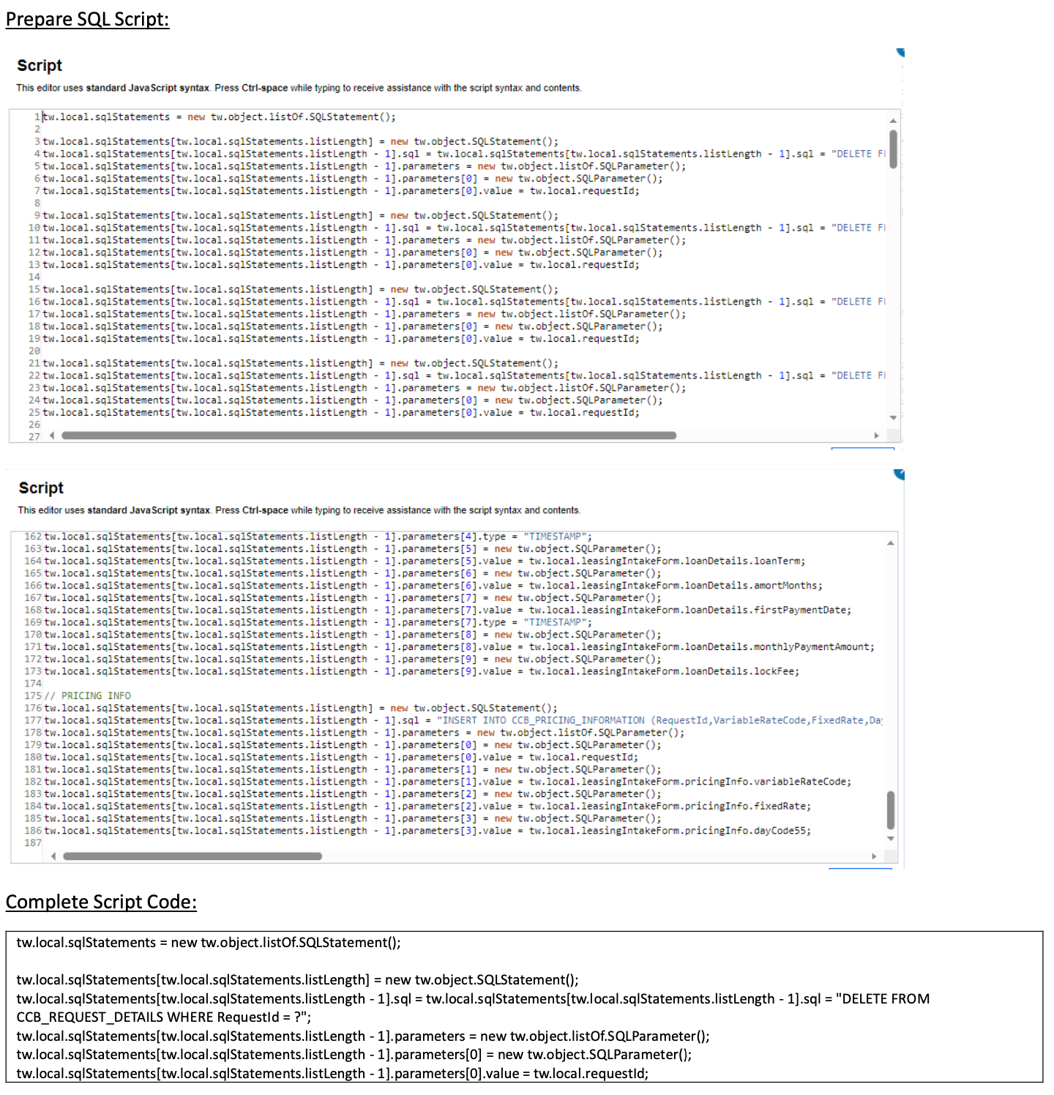
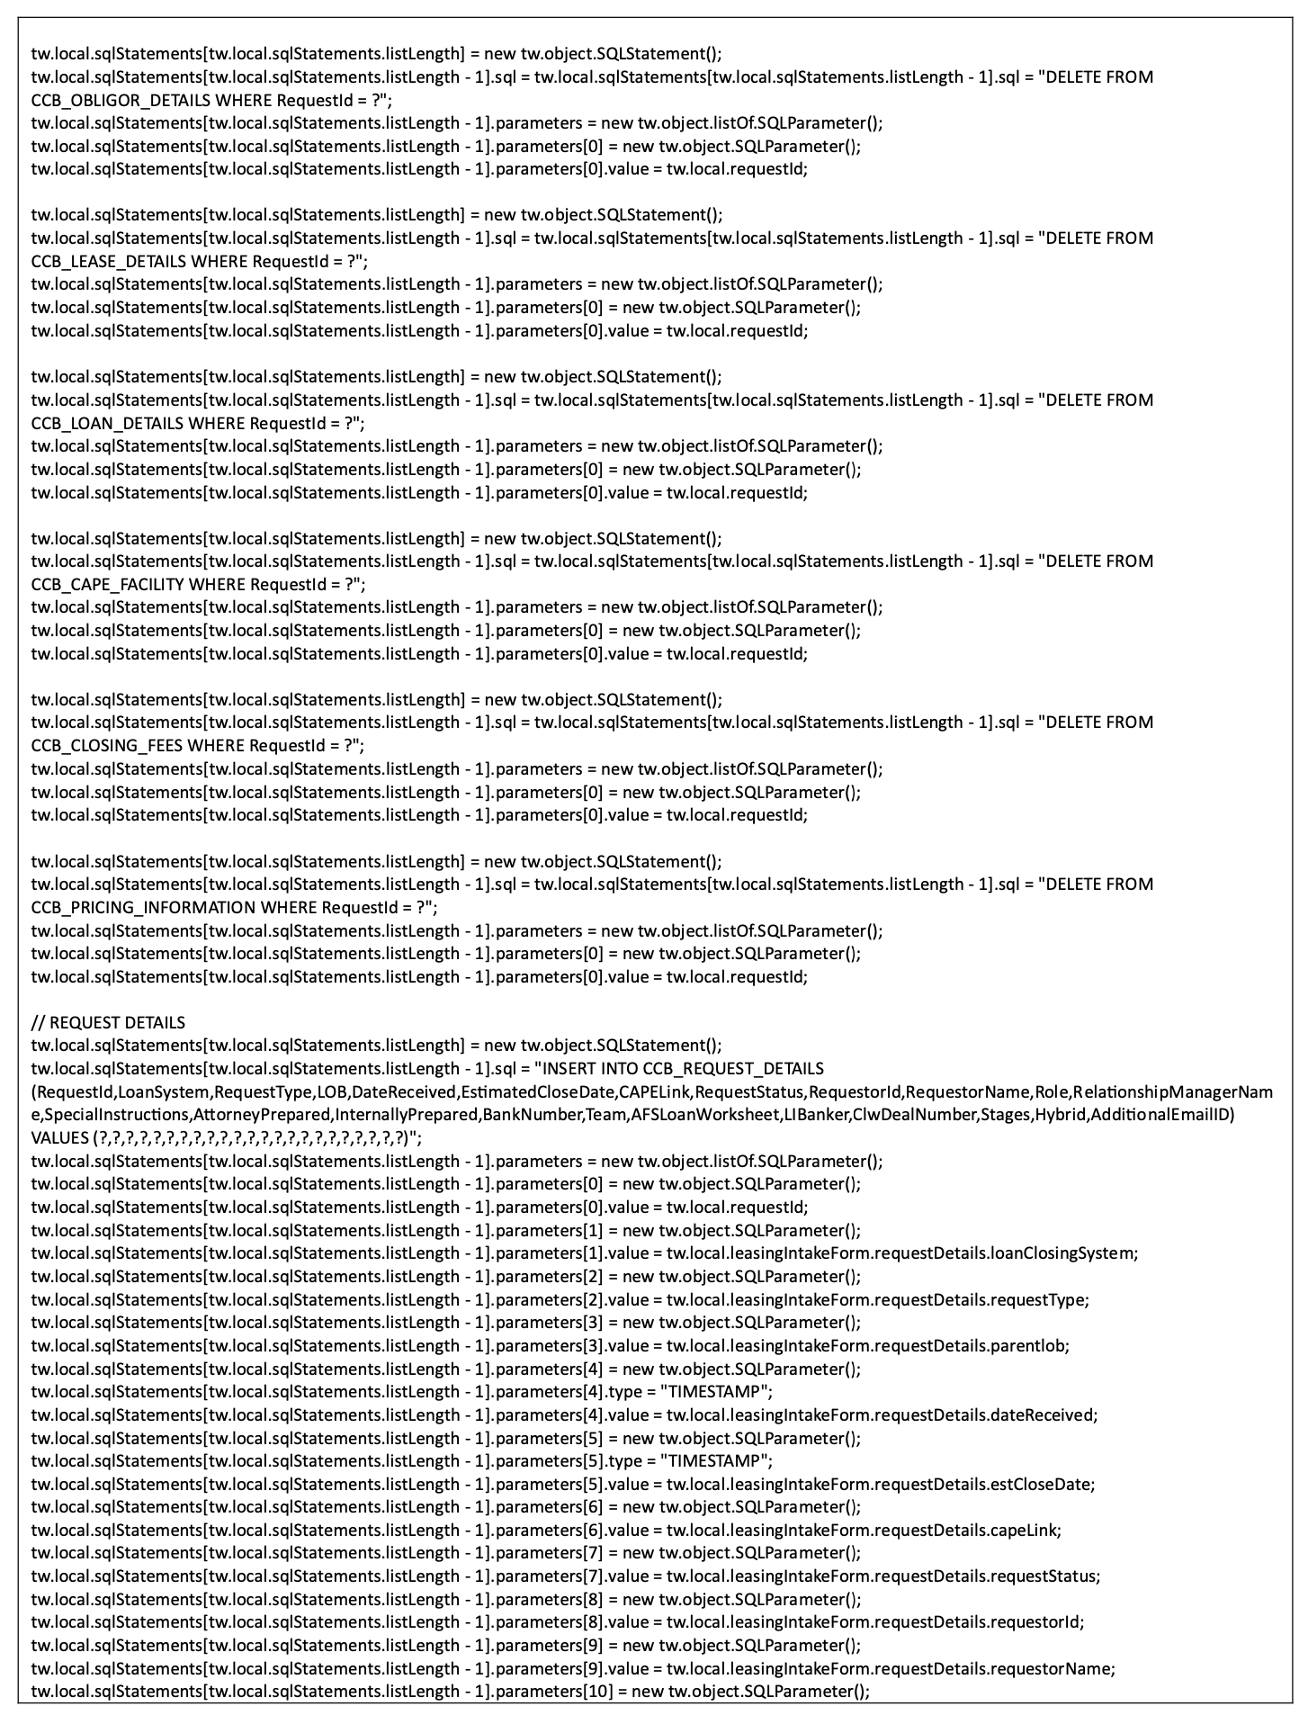
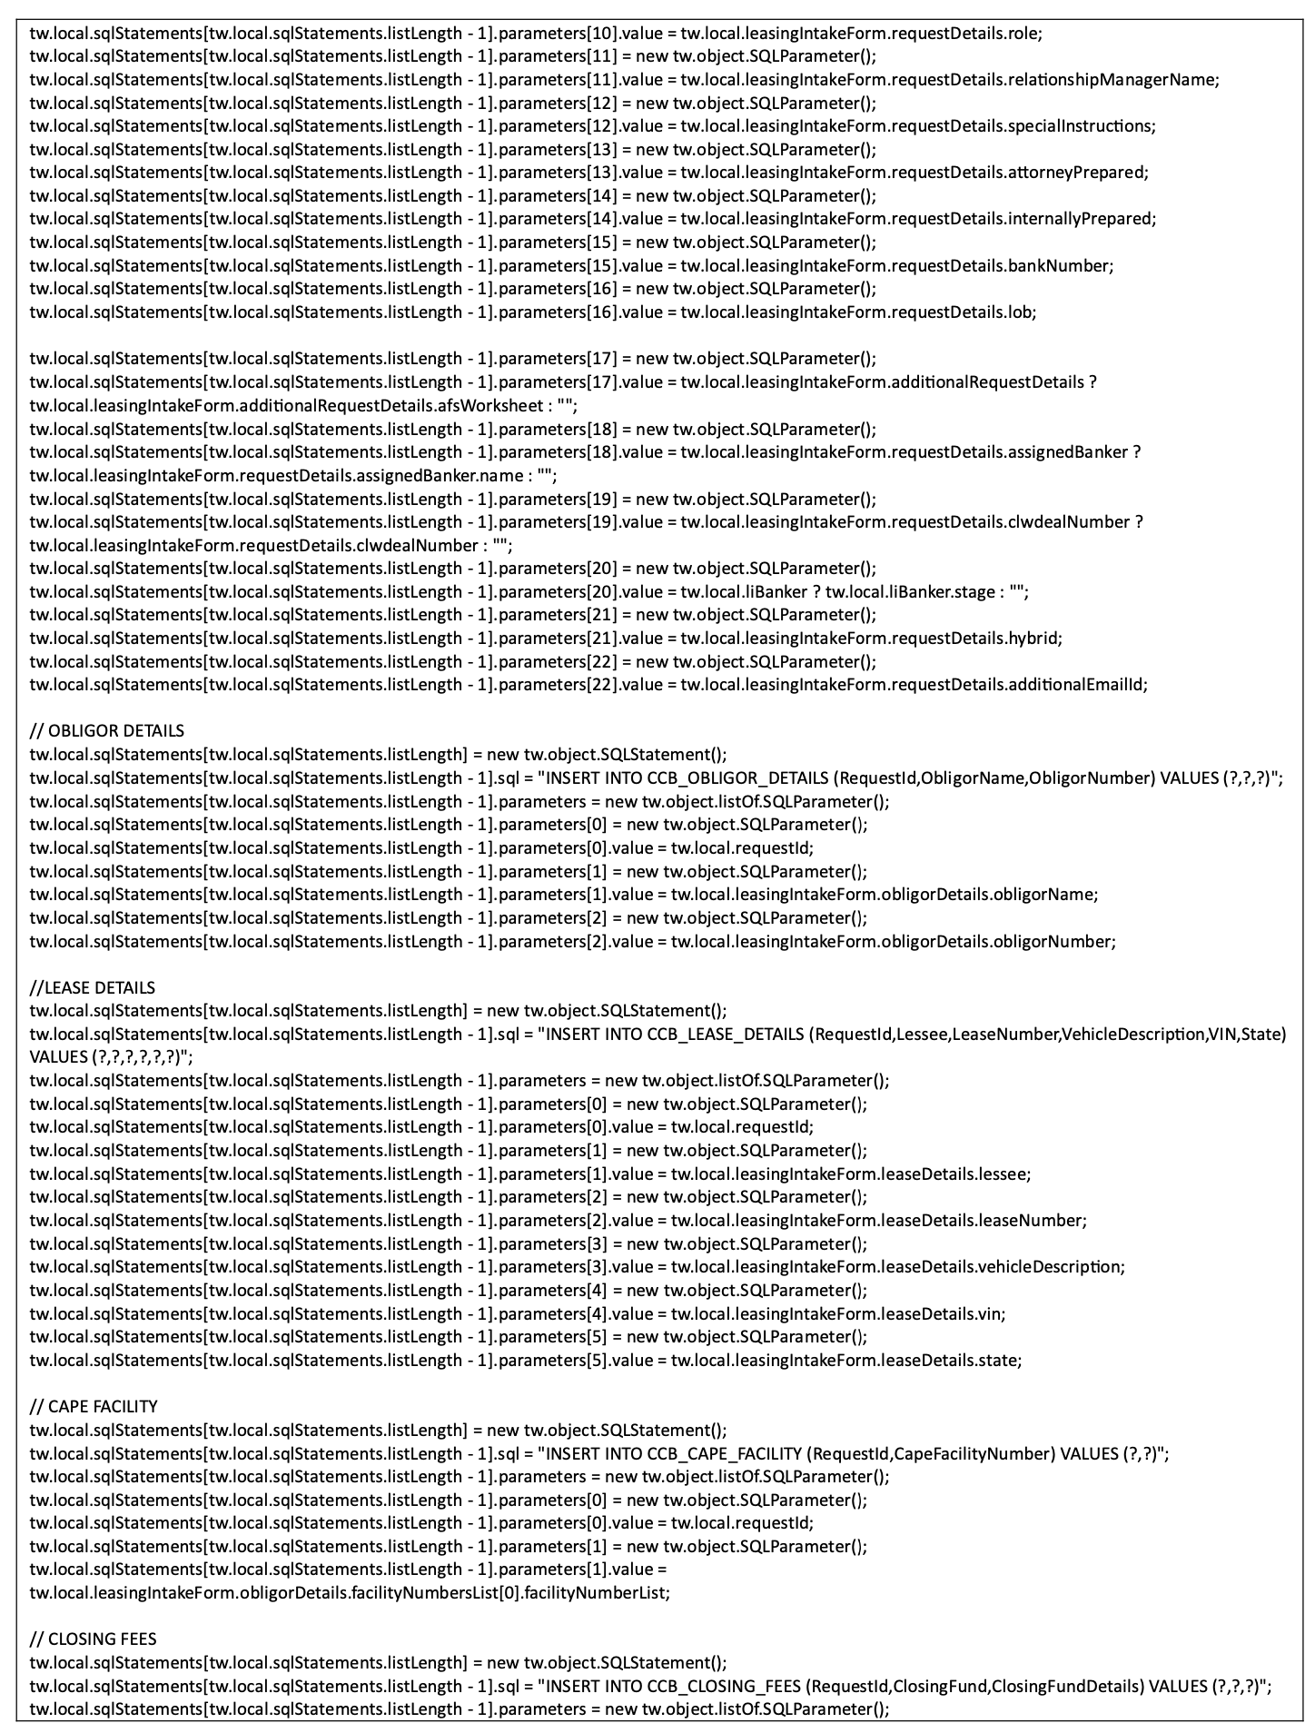
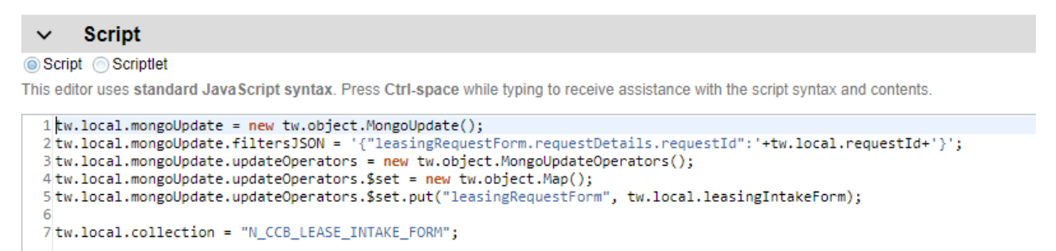
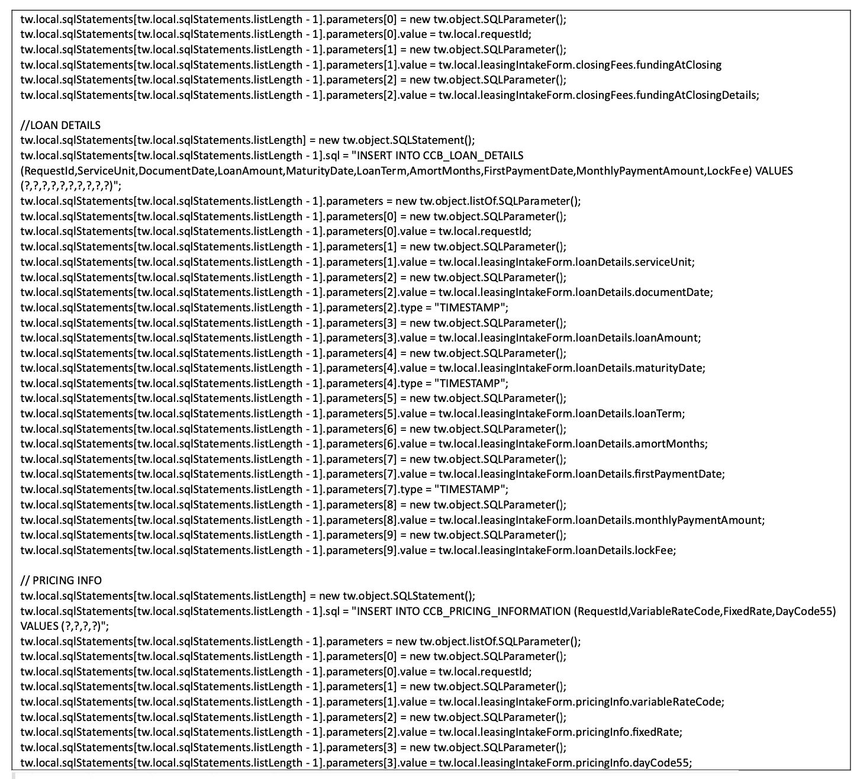
Always consistent flexible object Store (No SQL DB)
Development Cost Savings
Tons of code reduced to few lines instead to just bind object
Quick Access To Market
Flexible db model to incorporate object structure changes on the fly
Code samples from POC to Delete the existing record based on the RequestId and insert the new data. The data in SQL is maintained in different tables, so there are multiple deletions and inserts.

Slide 9
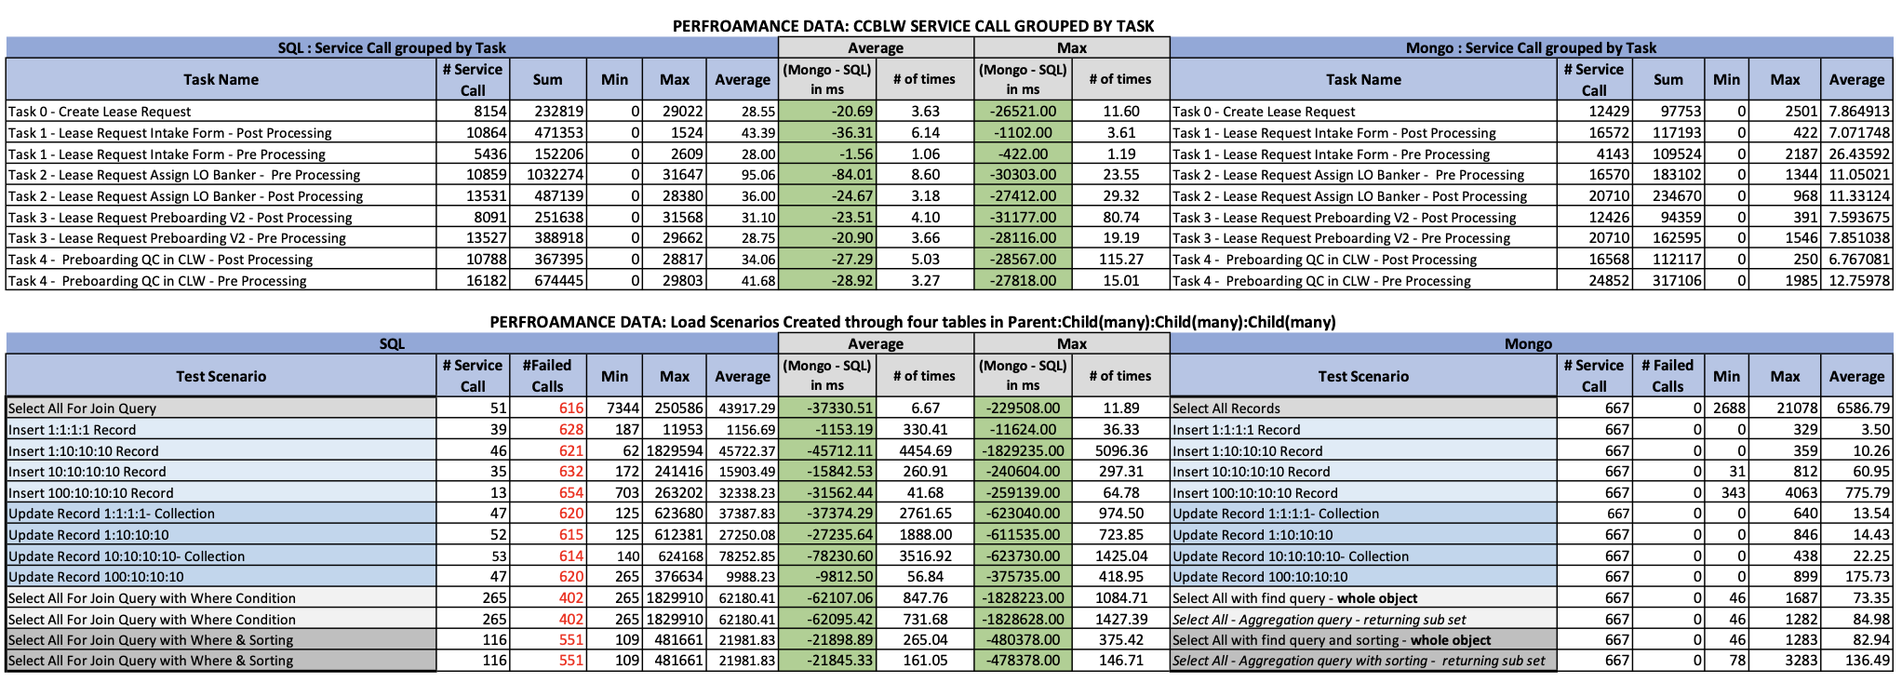
Always consistent flexible object Store (No SQL DB)
Improve Operational Efficiencies:
Much faster response times to save/retrieve objects
No Timeout, lockout issues:
Stability and Resiliency
No performance issues, db errors noticed in Load Test (SQL Server vs Mongo)

Slide 10
DB Strategy: Move to Mongo DB
Object Oriented DB supported through No SQL DB
Market
Unified Onboarding– Unified Onboarding can be a great fit for Mongo because Unified Onboarding event/ process instance is to handle one business transaction that is onboard a new account/client. Mongo DB can help improve performance, reduce infrastructure and reduce development cost esp. for new Unified Onboarding apps.
Servicing apps- The POC we conducted, proved that Mongo DB can resolve Production issues caused by DB, help improve performance, reduce infrastructure and reduce development cost for servicing apps.
Other Business Line Apps that handle a business transaction: They can be a good fit for mongo DB to enhance performance, reduce infrastructure and development cost.

Slide 11
Initiatives 4: Unified Servicing Portal - Introduction
Unified Portal for Servicing Apps based upon headless BAW implementation where Front end is in REACT.
Follows Unified Onboarding Framework and consuming its common assets and adding on top of it.
Unified Servicing Portal uses Common Object that can contain all application process instance/event data.
USP is integrated fully with CCBLW and partially with CTAO
Future Vision is:
Build more common task screens and migrate servicing apps towards headless implementation.
Common Object can grow to be able to incorporate more data for next task screens.
Servicing apps can partially move to USP before they eventually completely move to USP.
USP can redirect between USP task screens and BAW task screens.
Right now, focusing on building common Dashboard for servicing apps.
Build Screen Editor which can build templates, task screens, UI components.

Slide 12
Vision: Unified Servicing Portal Task Screens
BPM Corp Actions
Closed Deal File Checklist
Complex Assets Automation
USBI
SPQR
1. Dashboard
Task Tabs
Filtering
Request Details
Print
Reassign Task
Filenet
2. Task Manager
1. Dashboard
2. Analyst Task
1. Dashboard
Filenet
2. Valuation
SMONIK
Filenet
Dashboard
Custom Access
Print/Edit Request
Electronic File Upload
Filenet
2. Create Request
Phase 3
Upload Attachments
1. Initiate and Submit Request
2. Review Request
3. Perform Dual Authorization
4. Pend or Post Assets
3. Processor
Employee Service
GraphQL
SMTP
4. Second /Third Approver
Filenet
3. Banker Task
4. Supervisor Task
3. Incoming Transaction
Arcaria
Filenet
4. Outgoing Transaction
Arcaria
Filenet
3. eSign Receipt
Upload Attachments
3. Form Upload
Upload Attachments
5. Submit ACATS Delivery
6. Street Side Instructions
7. Settle/Super Settle Assets
8. Cancel Trades
5. Manage Memo Stationery
Create, Edit, Delete
Upload Attachments
6. Update Routing Policy
Create, Edit, Delete
5. Compliance Task
5. Perform Backdating
Filenet
6. Secondary Review
Filenet
4. Process Request
Upload Attachments
5. Advice Capture Request
Upload Attachments
3. Perform Asset Analysis
4. Post T2T Transactions
5. Process Global T2T Transfer
6. T2T Transfer Physical Assets
3. Review Receipt Instructions
4. Send Confirm ACATS
Shared Dashboard
5. Street Side Receipt
6. Confirm/Post Receipt
Common Screen
7. Additional Processing
8. Apply Cost Basis
Workflow 1
Workflow 2
9. Select Recipients and Send Statement
Workflow 3
Note: high-level diagram; limited workflows and integrations displayed
Notes:
Future state is to make all these workflows and screens accessible from one Unified Servicing Portal.
Our first focus is creating the shared dashboard.

Slide 13
Unified Servicing Dashboard
7
4
1
3
5
2
6

Slide 14
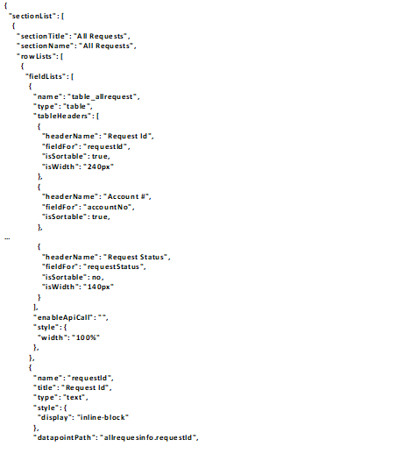
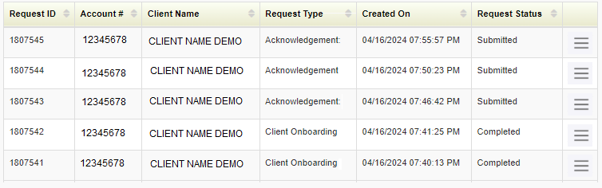
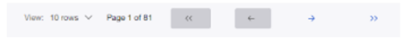



UI/UX Editor
Editor
Common Object
API
1
Create UI
Update UI
JSON Editor and UI Preview
2
3
4
5
Application USBI
UI Dashboard
Section AllRequest_Tab
$$<$$
$$<$$
$$<$$
Component AllRequest_Table
$$<$$
UI Preview
6
Reset
Update

Slide 15
Appendix

Slide 16
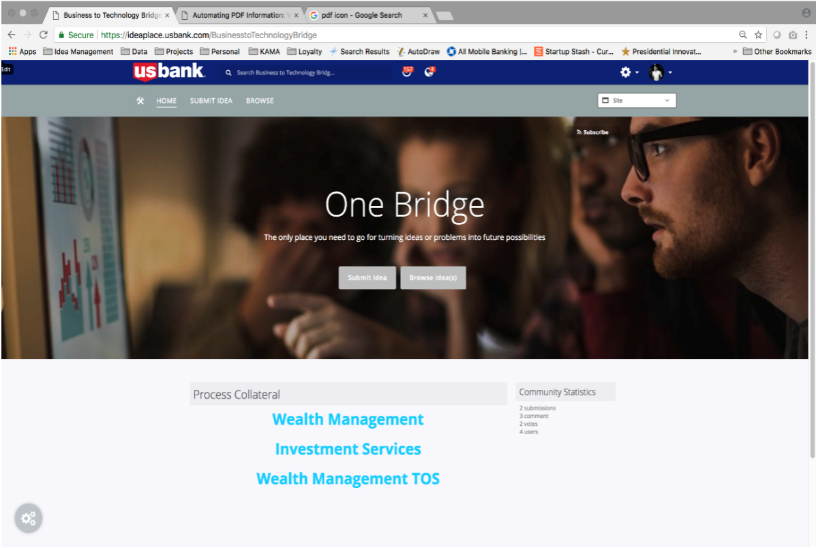
Notes:
PROBLEM
Our survey and the resulting synthesis confirmed this hunch.
There was no ONE solution that people sought with their problems or ideas
Currently people are using whatever means they have based on their own experiences, that work well for them
OPPORTUNITY
We also know that there will need to be a lot of communication around the new solution, as well as an annual training element, so that all employees know about this solution and how to use it.

Slide 17
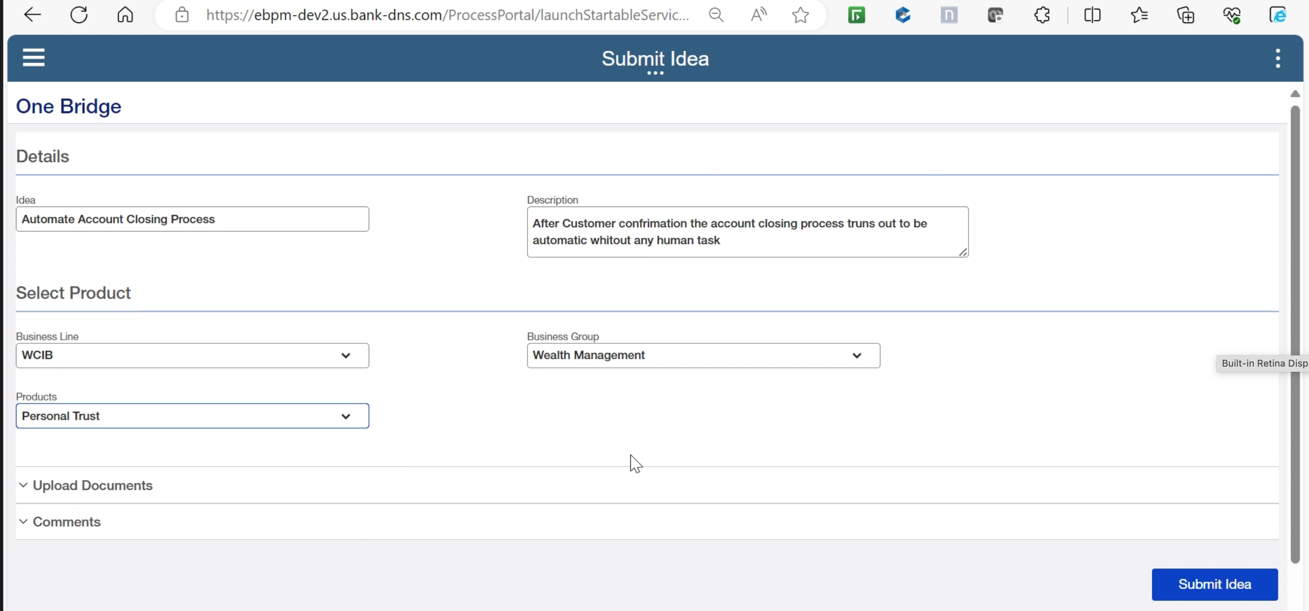
Notes:
PROBLEM
Our survey and the resulting synthesis confirmed this hunch.
There was no ONE solution that people sought with their problems or ideas
Currently people are using whatever means they have based on their own experiences, that work well for them
OPPORTUNITY
We also know that there will need to be a lot of communication around the new solution, as well as an annual training element, so that all employees know about this solution and how to use it.

Slide 18
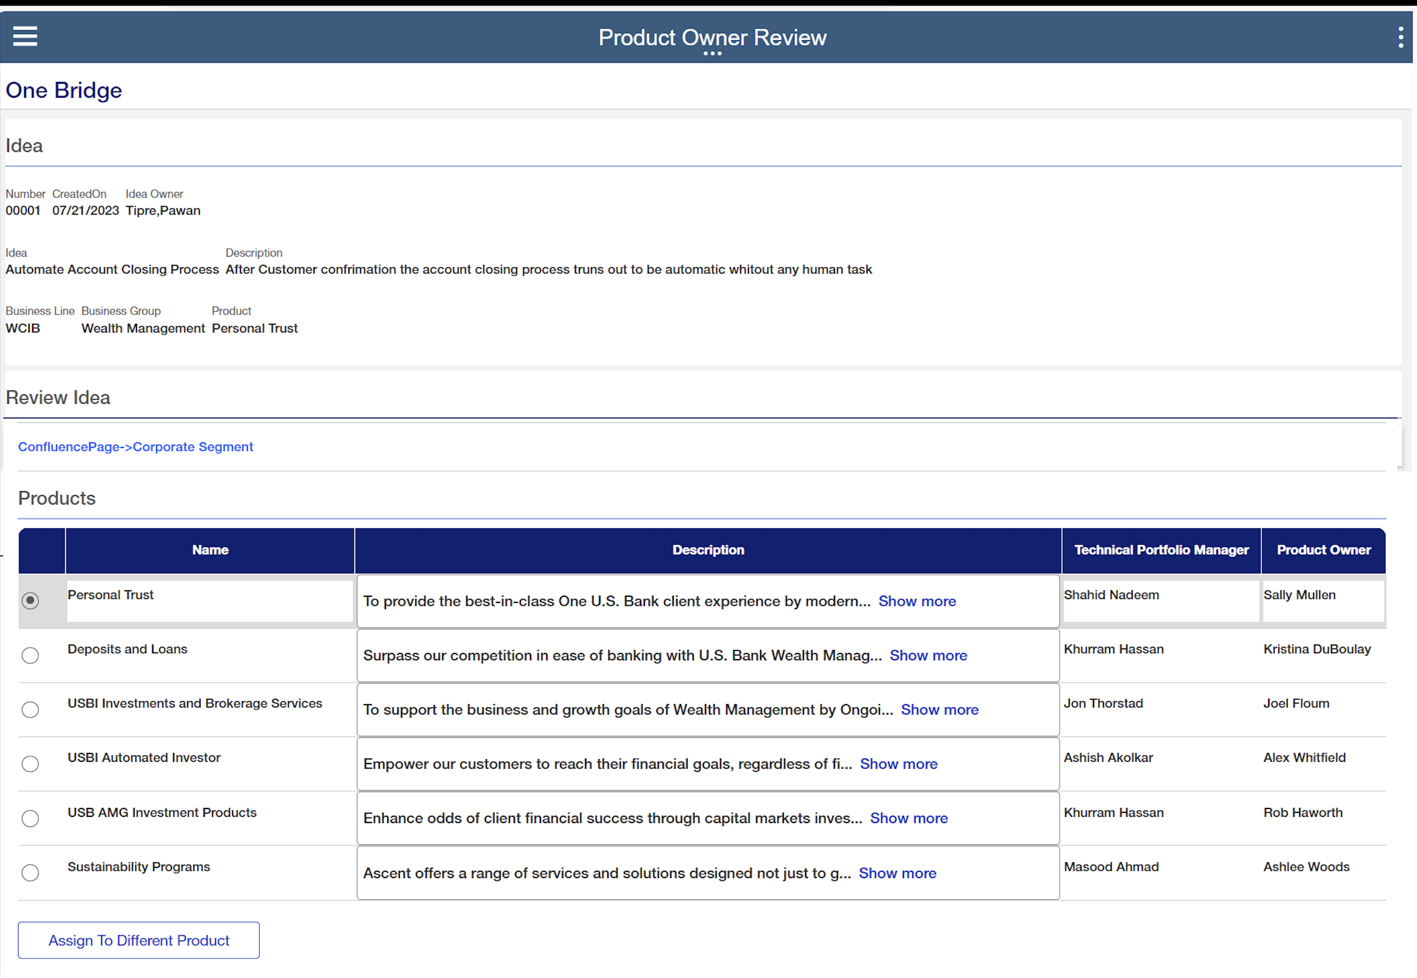
Notes:
PROBLEM
Our survey and the resulting synthesis confirmed this hunch.
There was no ONE solution that people sought with their problems or ideas
Currently people are using whatever means they have based on their own experiences, that work well for them
OPPORTUNITY
We also know that there will need to be a lot of communication around the new solution, as well as an annual training element, so that all employees know about this solution and how to use it.

Slide 19
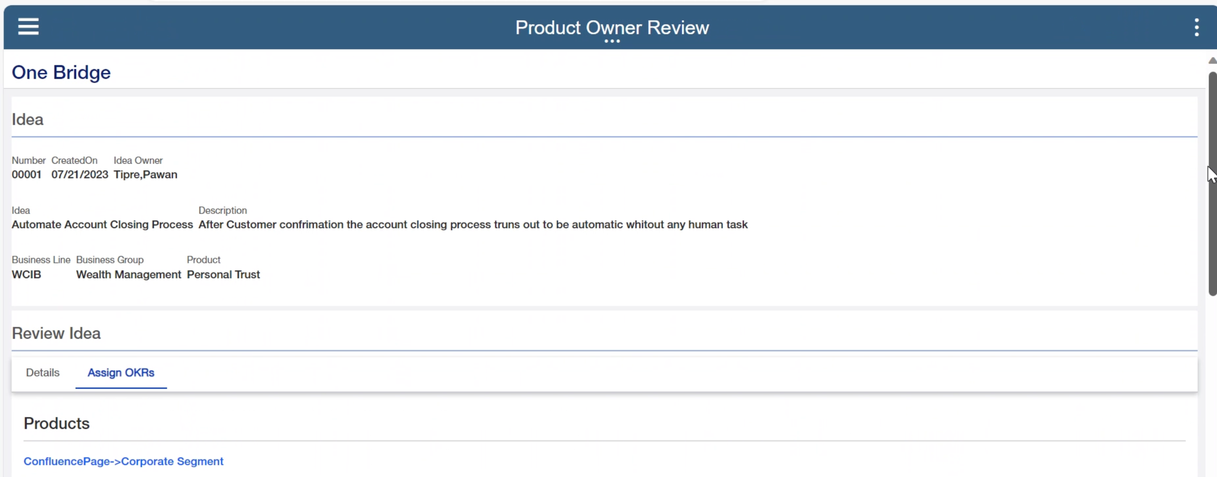
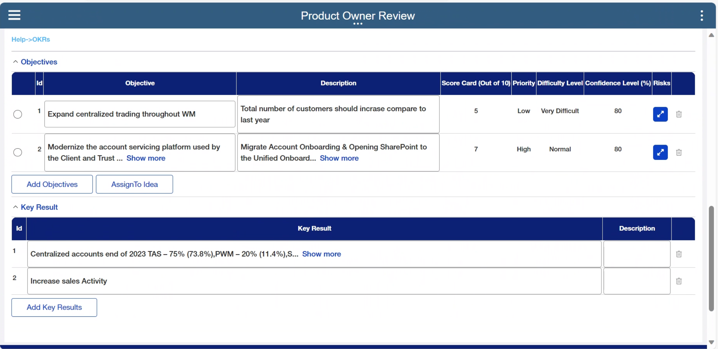
Notes:
PROBLEM
Our survey and the resulting synthesis confirmed this hunch.
There was no ONE solution that people sought with their problems or ideas
Currently people are using whatever means they have based on their own experiences, that work well for them
OPPORTUNITY
We also know that there will need to be a lot of communication around the new solution, as well as an annual training element, so that all employees know about this solution and how to use it.

Slide 20

Notes:
PROBLEM
Our survey and the resulting synthesis confirmed this hunch.
There was no ONE solution that people sought with their problems or ideas
Currently people are using whatever means they have based on their own experiences, that work well for them
OPPORTUNITY
We also know that there will need to be a lot of communication around the new solution, as well as an annual training element, so that all employees know about this solution and how to use it.

